Slide 1
Final Project: Branch Prediction
Paul-John Clet
ECSE 6680 – Advanced VLSI Design | 04/18/24

Slide 2




Agenda
Introduction
What is branch prediction?
Why is it useful?
System Architecture
High level design
Component analysis
Testing
RISC-V code
Testbench and results
Conclusion
Future work

Slide 3
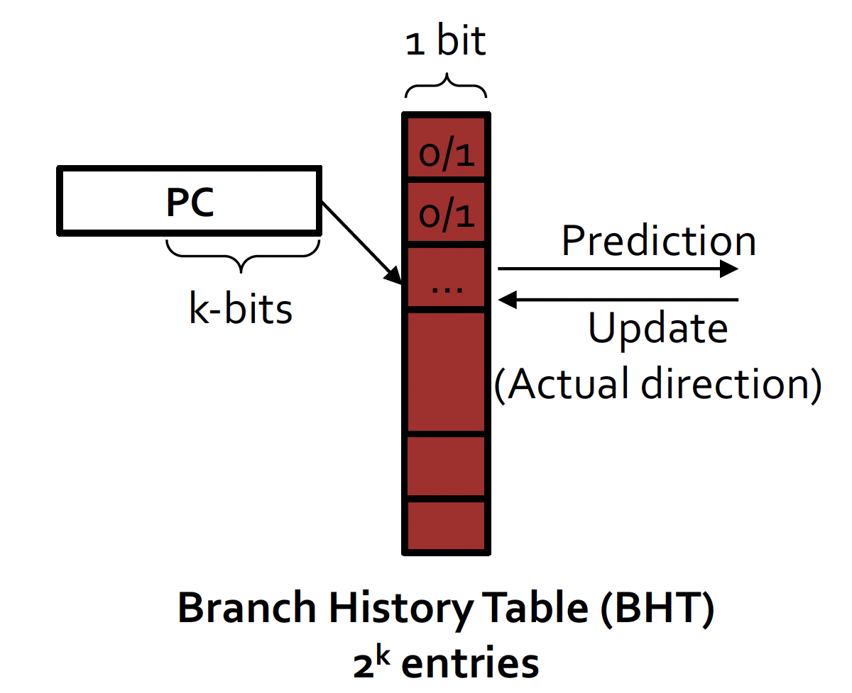
What is Branch Prediction?
Branch Prediction (BP) – Technique used in CPU design to guess the outcome of a conditional statement before it is calculated [1]
Essentially decide to take a branch/jump based on the PC and branch history
Various forms of dynamic branch predictors:
1-bit predictors – for each branch, remember the last outcome
2-bit predictors – introduce strong/weak taken and not taken
2-level predictors – introduce a global history
Figure 1: Single bit predictor example [2]

Slide 4
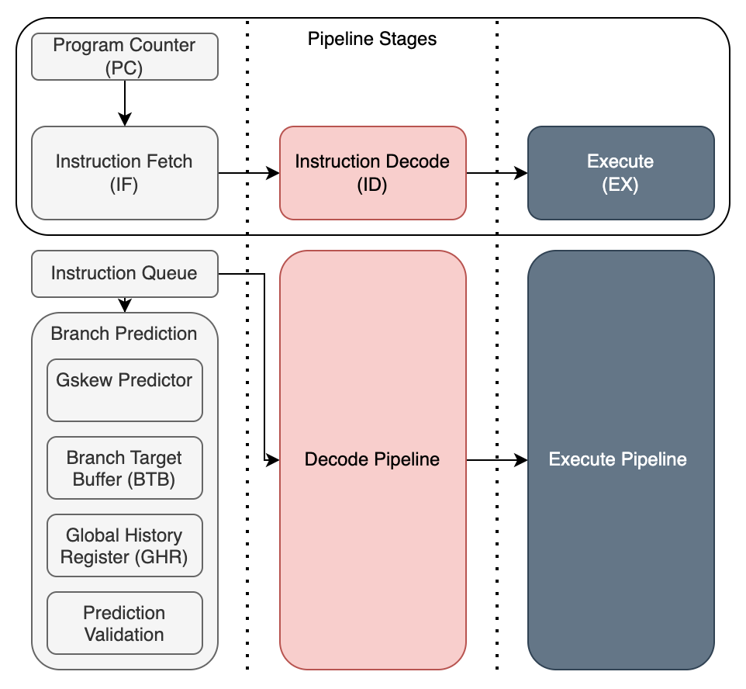
Why is it Useful? (1)
This project’s design uses a simplified 3 stage RISC-V processor architecture
Leverage branch prediction to minimize the number of clock cycles lost
Potential to save many clock cycles in a modern CPU
Figure 2: 3 stage RISC-V processor pipeline stages with branch prediction
Notes:
Show cycles here

Slide 5
Why is it Useful? (2)
4 cases for a branch/jump instruction
With BP, the penalty is on the cases where branch prediction is incorrect
Can rely on branch prediction for saving cycles
Modern branch predictors have >95% accuracy [2]
Prediction | Actual | Number of Clock Cycles Lost
 |  | Without BP | With BP
Not Taken | Not Taken | 0 | 0
Not Taken | Taken | 2 | 2
Taken | Not Taken | 0 | 2
Taken | Taken | 2 | 0
Notes:
Show cycles here

Slide 6
Agenda
Introduction
What is branch prediction?
Why is it useful?
System Architecture
High level design
Component analysis
Testing
RISC-V code
Testbench and results
Conclusion
Future work

Slide 7
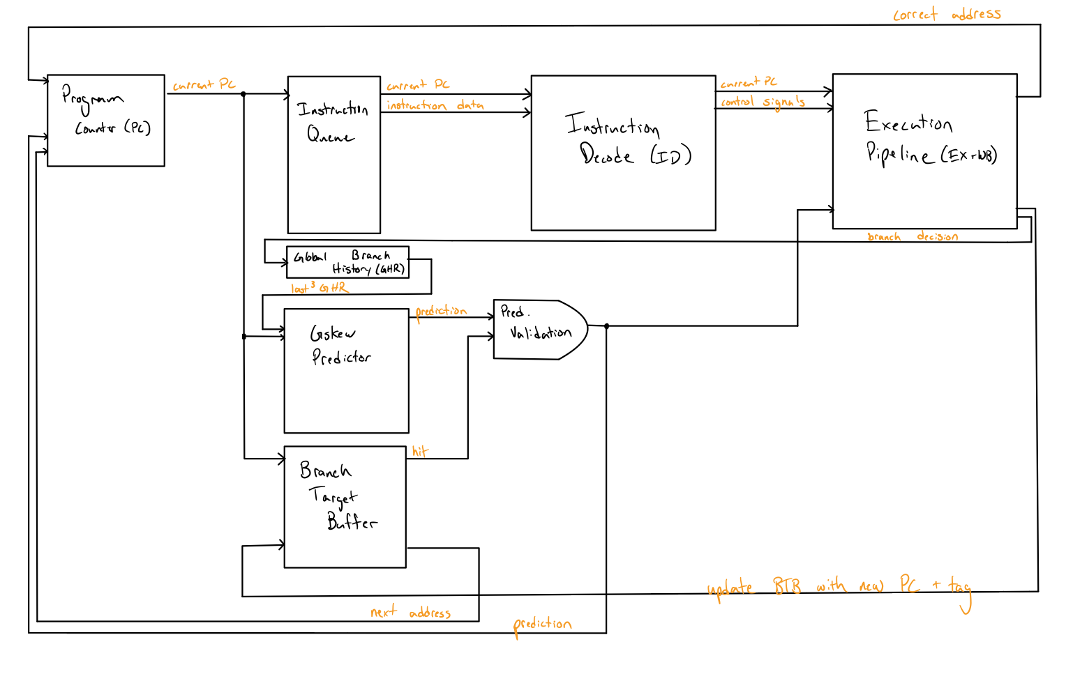
High Level Architecture
8 individual modules designed (+2 for testbench and toplevel)
4 modules for RISC-V CPU pipeline
Program Counter (PC)
Instruction Queue
Instruction Decode Pipeline
Execution Pipeline (Includes EX+WB stages)
4 modules for BP
Global Branch History Register (GHR)
Gskew Predictor
Branch Target Buffer
Prediction Validation
Figure 3: Simplified system for branch prediction, including all modules

Slide 8
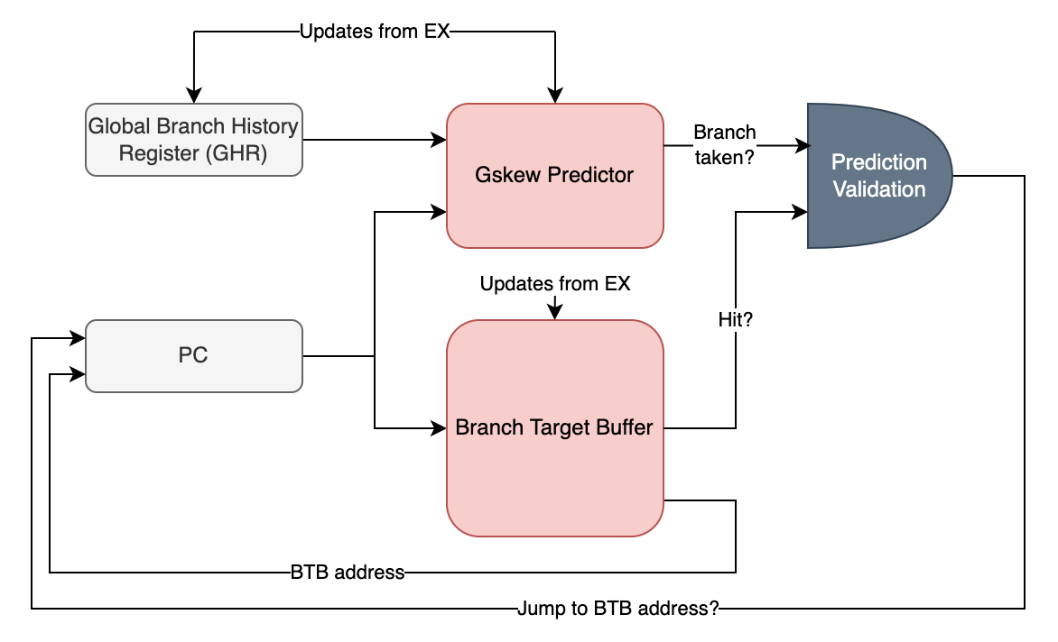
Branch Prediction Component Analysis
Focus on Branch Predictor Architecture and Functionality
Prediction Steps:
Get GHR and PC bits
Decide if the branch is taken based on Gskew predictor (next slide)
Check if there is a hit in the BTB
If and only if both are true, output true to PC, taking the BTB address
Figure 4: Branch prediction modules and general functionality

Slide 9
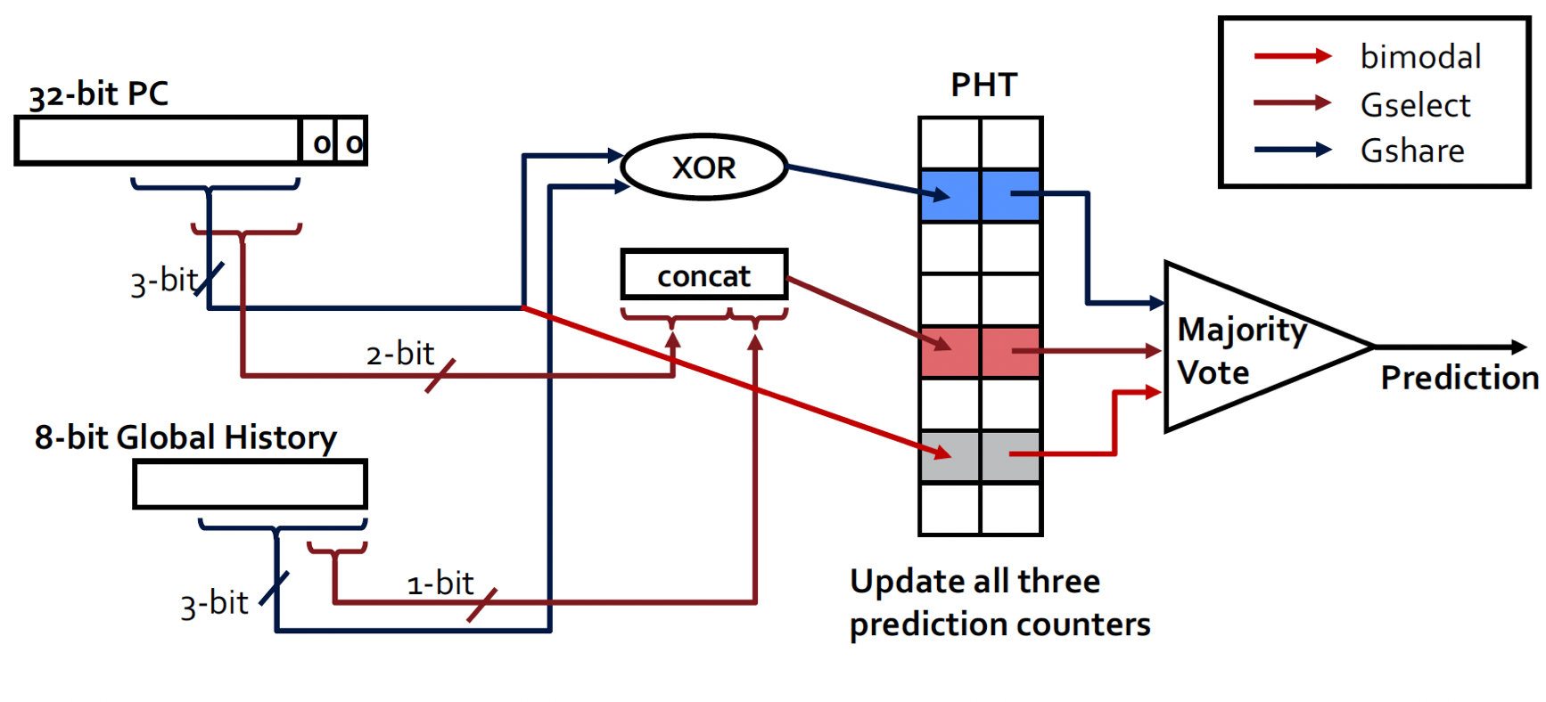
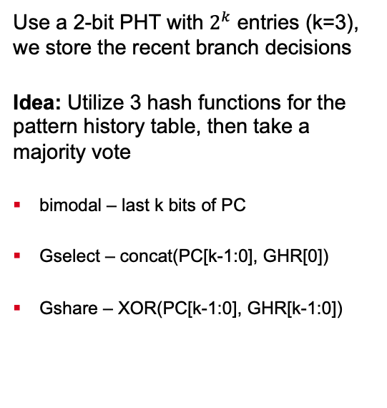
Component Analysis – Gskew Predictor
Use a 2-bit PHT with $2^{k}$ entries (k=3), we store the recent branch decisions
Idea: Utilize 3 hash functions for the pattern history table, then take a majority vote
bimodal – last k bits of PC
Gselect – concat(PC[k-1:0], GHR[0])
Gshare – XOR(PC[k-1:0], GHR[k-1:0])
Figure 5: Gskew predictor module breakdown [3]

Slide 10
Agenda
Introduction
What is branch prediction?
Why is it useful?
System Architecture
High level design
Component analysis
Testing
RISC-V code
Testbench and results
Conclusion
Future work

Slide 11
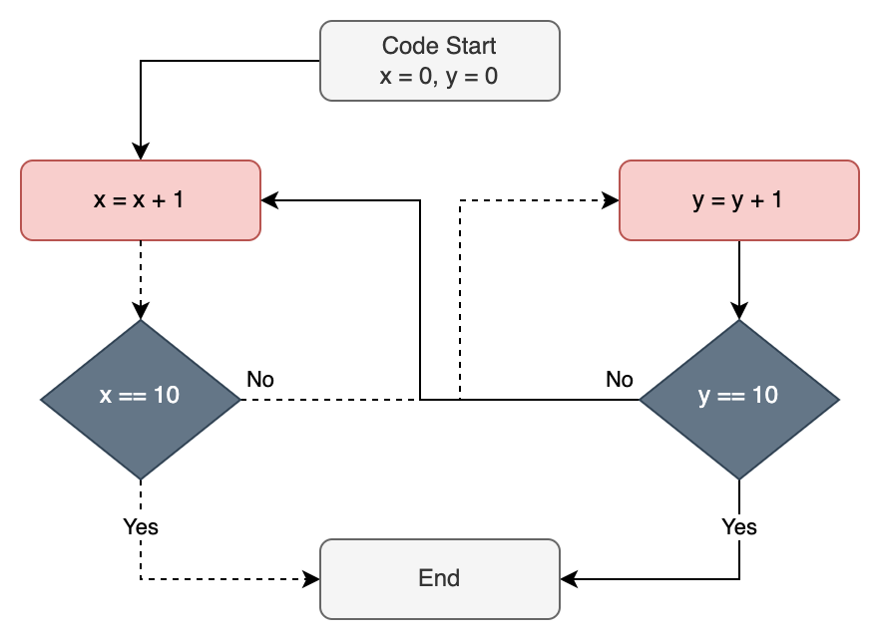
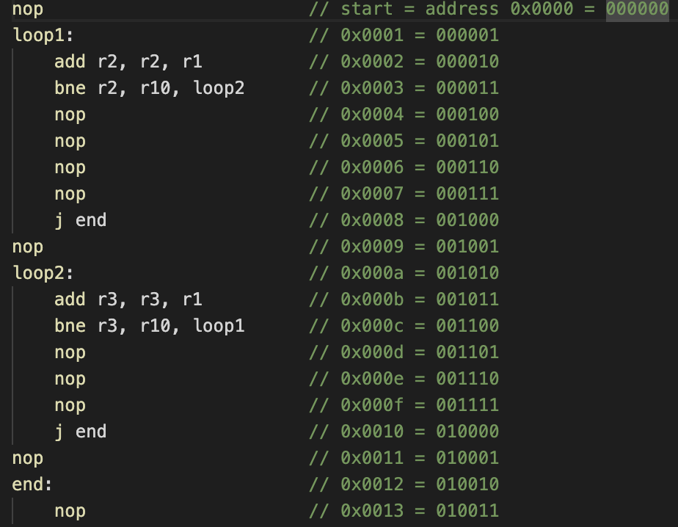
Test Code (1)
Goal: Use branch instructions, show performance with/without successful BP
Figure 6: Original RISC-V code for testing BP
Figure 7: Converted code flow chart

Slide 12
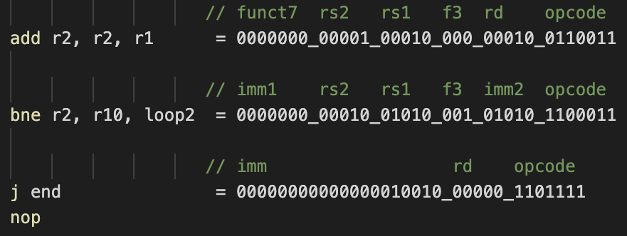
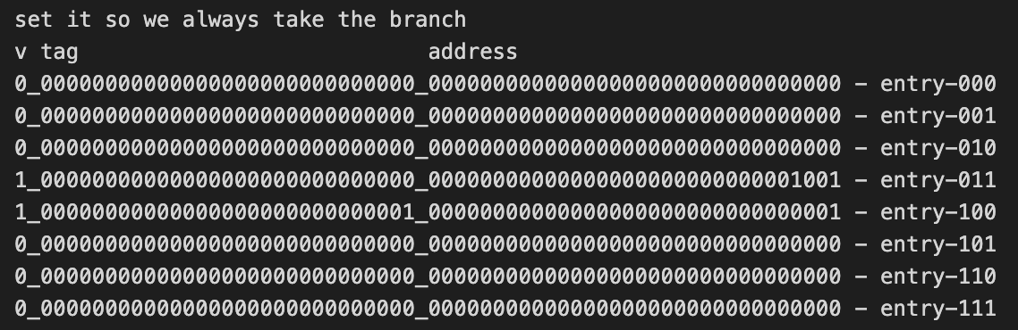
Test Code (2)
Translate and load all the instructions
Follow RISC-V architecture with 3 types of instructions: R, SB, UJ
Pre-load the Branch Target Buffer
Load the two branch addresses in at their respective addresses
Pre-load the PHT
Set each of the 8 entries to 10 (Weak taken)
Figure 8: Breakdown for each instruction in RISC-V
Figure 9: Input to the Branch Target Buffer, allowing the two branch instructions to jump to each other

Slide 13
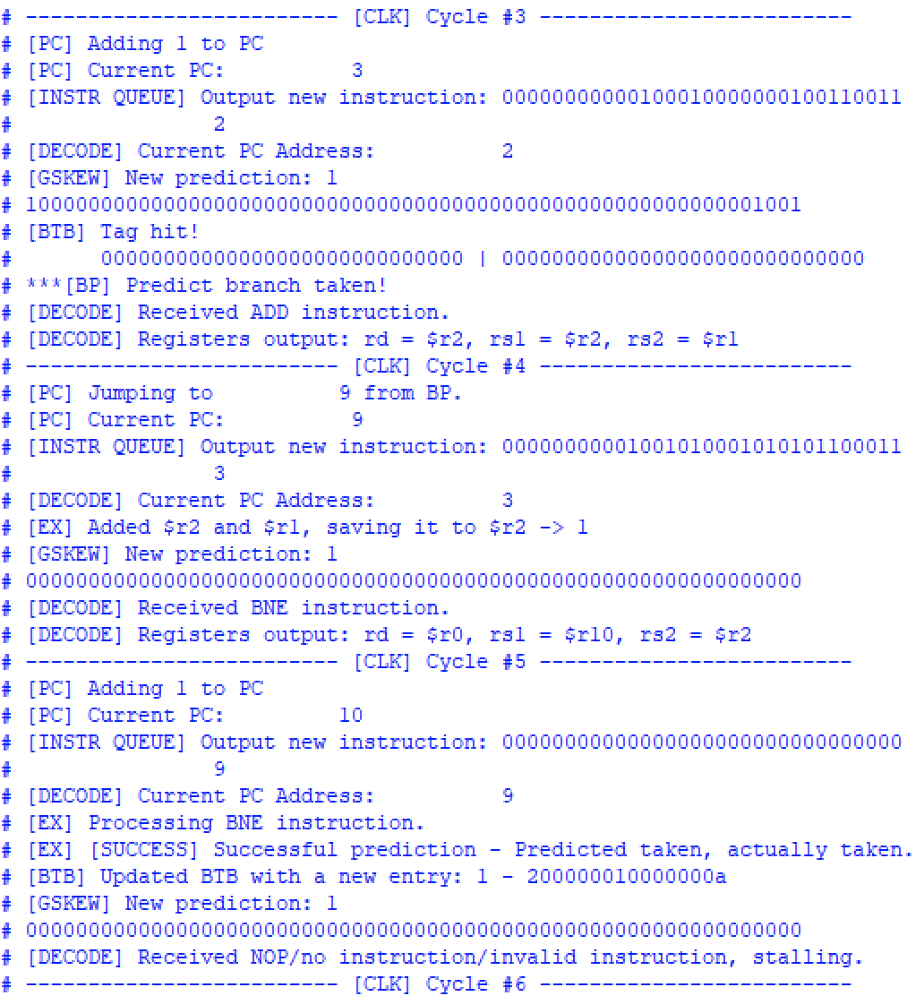
Simulation Results (1)
Partial console output from ModelSim with branch always taken
Clock Cycle
Instr
3 4 5
add r2, r2, r1
bne r2, r10, loop2
nop
ID
EX
IF
ID
EX
IF
ID
Figure 10: ADD and BNE instructions successful output
Notes:
Show cycles here

Slide 14
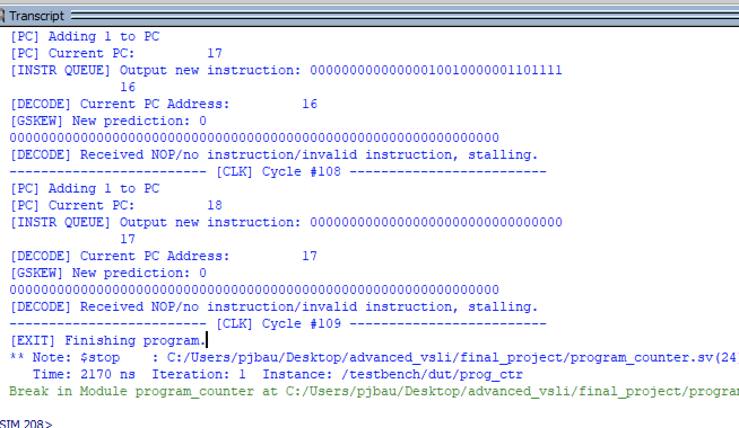
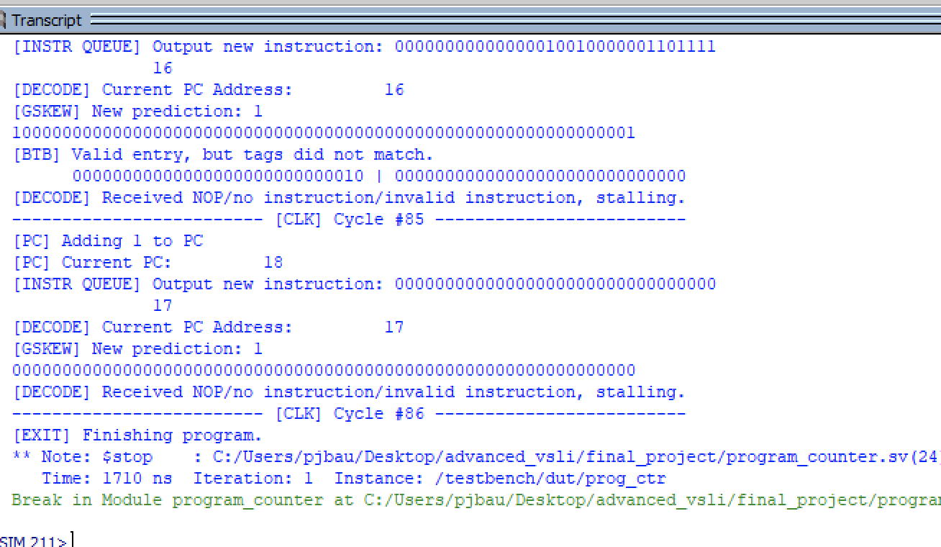
Simulation Results (2)
Without Branch Prediction
With Branch Prediction
Figure 11: Simulation results without branch prediction (109 cycles to completion)
Figure 12: Simulation results with branch prediction (86 cycles to completion)
Saved 23 clock cycles – 21% reduction
Can have much greater reduction based on the number of pipeline stages
Can also have negative impacts based on the program and prediction accuracy
Notes:
Show cycles here

Slide 15
Agenda
Introduction
What is branch prediction?
Why is it useful?
System Architecture
High level design
Component analysis
Testing
RISC-V code
Testbench and results
Conclusion
Future work

Slide 16
Conclusion and Future Work
Combined Gskew predictor with BTB to perform branch prediction at the IF stage
Designed a program to test branch prediction functionality using RISC-V ISA
Achieved at 21% runtime reduction with a 3-stage pipeline with potential to save many cycles in a modern CPU
Future Work
Fully implement updates to PHT
Extend to a longer and more complex pipeline to see full benefits
Implement more instructions and instruction types, allowing for more complex programs to be executed

Slide 17
References
[1] What is a Branch Prediction, “What is a Branch Prediction?,” Computerhope.com, 2017. https://www.computerhope.com/jargon/b/branch-prediction.htm
‌[2] L. Liu, Class Lecture, Topic: “Advanced Computer Architecture: Branch Prediction.”, ECSE 4780/6700, College of Engineering, Rensselaer Polytechnic Institute, Troy, NY, Mar. 2024.
[3] L. Liu, Class Lecture, Topic: “Advanced Computer Architecture: Branch Prediction II.”, ECSE 4780/6700, College of Engineering, Rensselaer Polytechnic Institute, Troy, NY, Mar. 2024.
[4] ltziyan He, “Design a Three-Stage Pipelined RISC-V Processor Using SystemVerilog KTH Thesis Report.” Available: https://www.diva-portal.org/smash/get/diva2:1713647/FULLTEXT01.pdf
‌[5] Mutlu, “8-740/640 Computer Architecture Lecture 5: Advanced Branch Prediction,” 2015. Accessed: Apr. 12, 2024. [Online]. Available: https://course.ece.cmu.edu/~ece740/f15/lib/exe/fetch.php?media=18- 740-fall15-lecture05-branch-prediction-afterlecture.pdf
‌
Notes:
https://www.educative.io/answers/what-is-branch-prediction
#] Lecturer(s) Initial(s). Surname(s), Class Lecture, Topic: "Lecture title.” Unit Code, College/Faculty, University, Location, Abbrev. Month, Day, Year.
Referencing elements to cite:
[#] Reference number (matching the in-text citation number)
Lecturer’s first initial. Lecturer’s second initial, if provided. Lecturer’s last name
Class Lecture
Topic: Lecture title in lower case
Unit Code
College/Faculty
Location: City
Abbrev. Month, Day, Year. Refer to the Abbreviated month section for further information
[1] H. King, Class Lecture, Topic: "Lecture 3- AC Circuits." NEF2251/VAM3112, College of Engineering and Science, Victoria University, Melbourne, Vic., Apr. 2016.

